Slide 1
Tutorial on Prompt Engineering and Metadata
Jian Qin and Bei Yu Syracuse University
Slides and code available at
https://github.com/scienceIQ/DCMI2023-tutorial-prompt

Slide 2
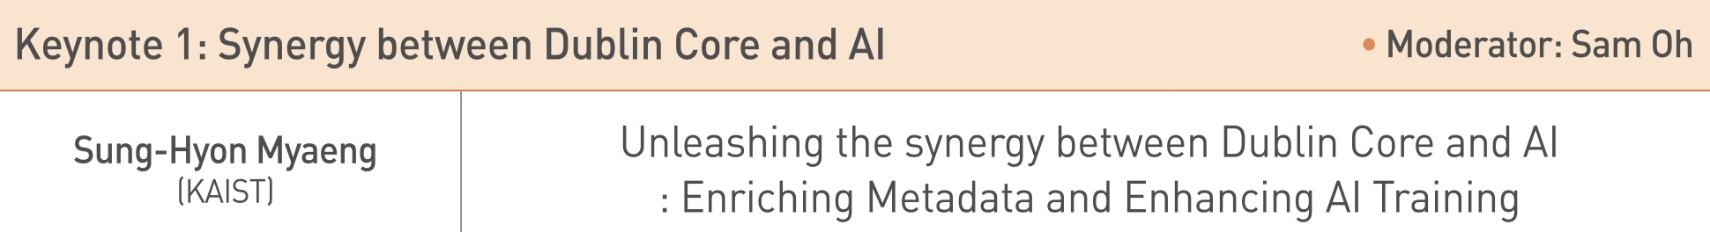
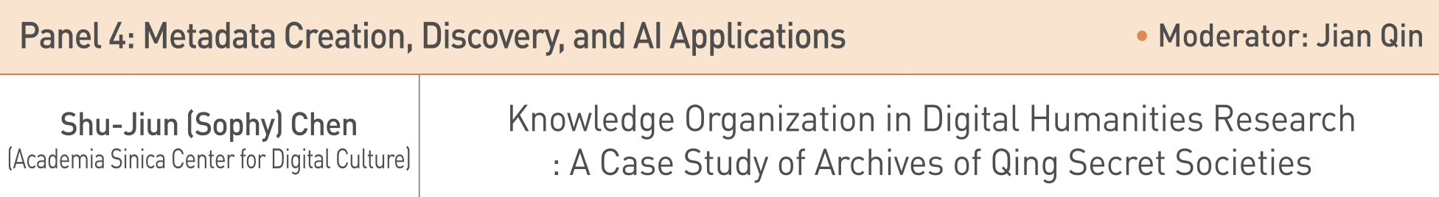
LLMs and Metadata
Machine Learning and Natural Language Processing techniques are often used for automatically extracting metadata from textual documents
LLMs have recently been used for automated data annotation/labeling/cataloging

Slide 3
Text classification for automatically generating metadata from text documents
Named-Entity Recognition (NER)
Sentence “The symptoms suggest a possible case of rheumatoid arthritis.”
NER tagging “O O O O O O O B-Disease I-Disease O”
Relation Extraction (RE)
Sentence “Smoking causes cancer”
Relation e1=“smoking”, e2=“cancer”, r= causal
Many other ad hoc classification tasks
MeSH terms
Subject Metadata

Slide 4
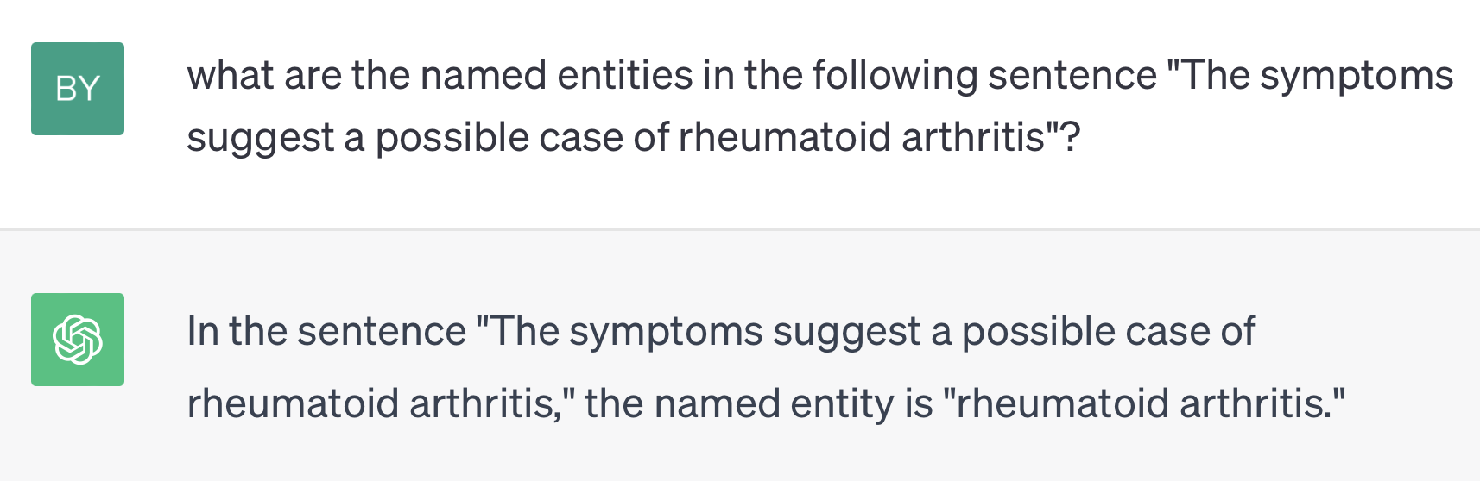
ChatGPT for named-entity recognition (NER)
Named-Entity Recognition (NER)
Sentence “The symptoms suggest a possible case of rheumatoid arthritis.”
NER tagging “O O O O O O O B-Disease I-Disease O”

Slide 5
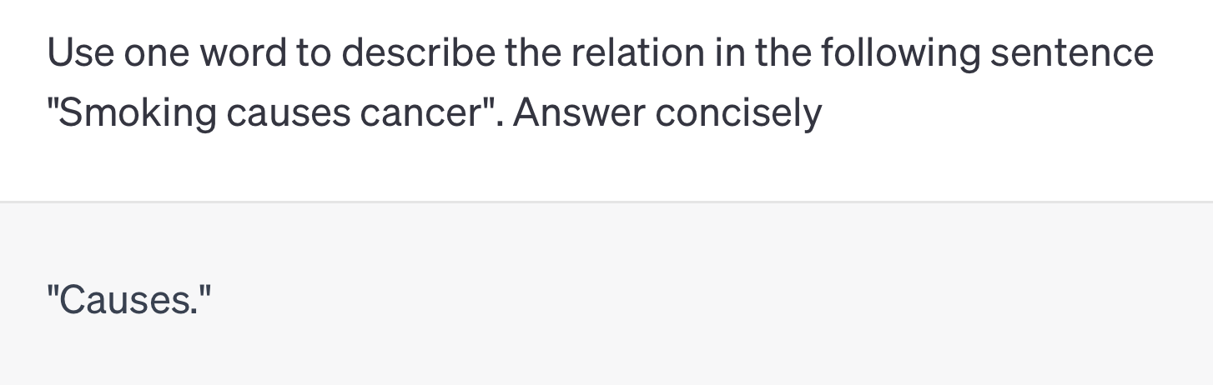
chatGPT for relation extraction
Relation Extraction (RE)
Sentence “Smoking causes cancer”
Relation e1=“smoking”, e2=“cancer”, r= causal

Slide 6
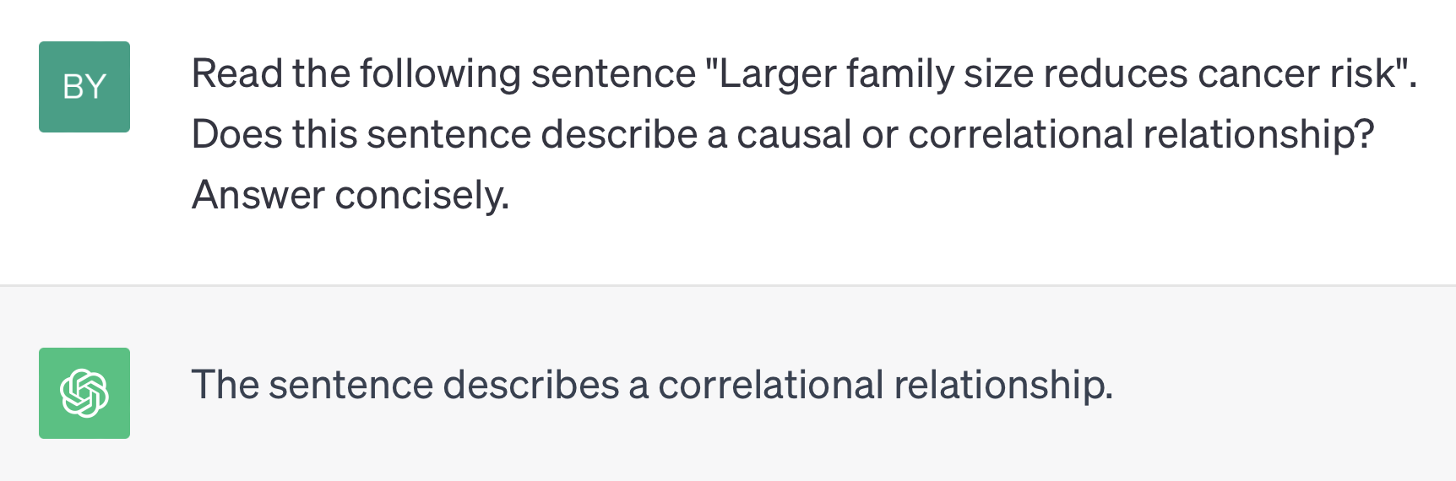
chatGPT for any text classification task
E.g. identify the strength of a science claim

Slide 7
Tutorial structure
Part I – the evolving NLP methodology
Part II – prompt engineering strategies
Part III – prompt engineering: science or alchemy?

Slide 8

Part I – the evolving NLP methodology

Slide 9
The evolving NLP methodology
First-generation methods: rules and lexicons
E.g. keyword search for “randomized clinical trial” to determine if a study is RCT
Second-generation methods: fully-supervised machine learning,
E.g. Linear text classifiers like SVMs
Strength
Interpretability – feature weights explain their salience for prediction
Challenges
Need a large amount of training data for sophisticated tasks
Need feature engineering to find most salient features for prediction

Slide 10
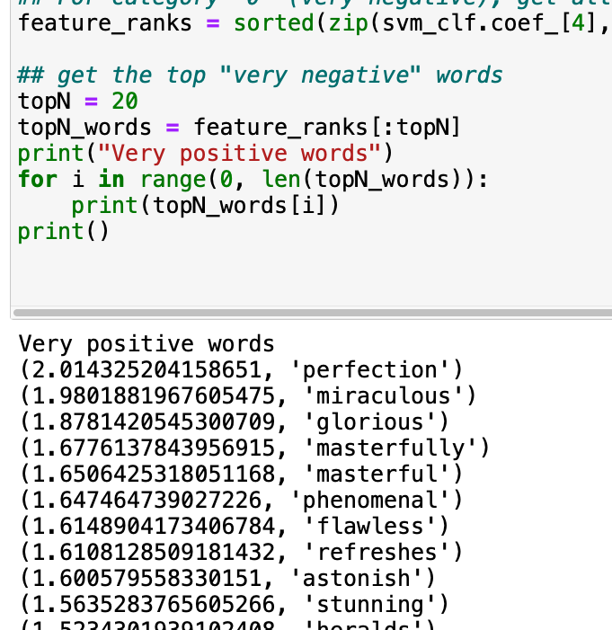
Fully-supervised learning
A task-specific model is trained on a task-specific data set.
These models often rely heavily on feature engineering, where researchers use their domain knowledge to select salient features from training data.

Slide 11
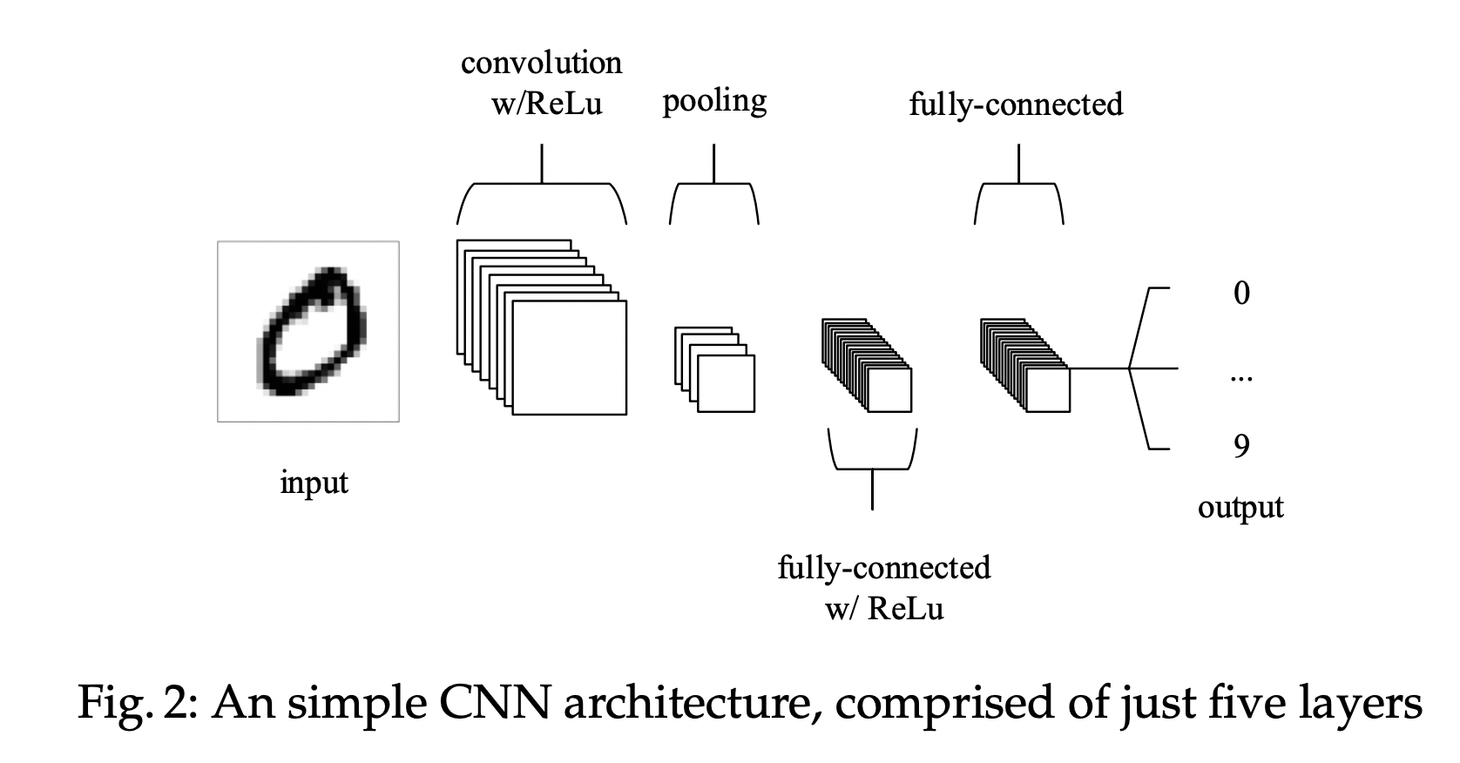
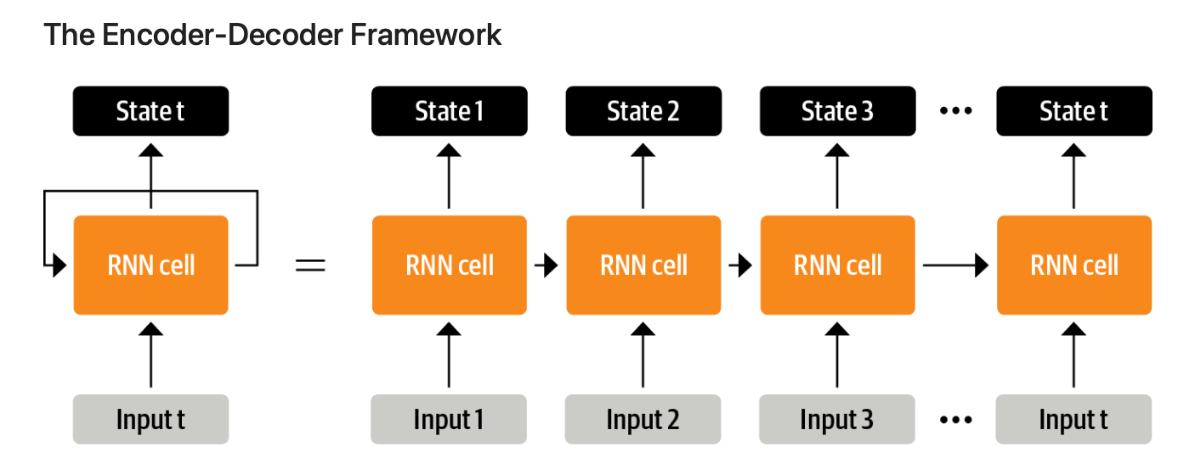
From feature engineering to architecture engineering
With neural network architecture, salient features are learned jointly with the training of the model itself
Tunstall, L., Von Werra, L., & Wolf, T. (2022). Natural language processing with transformers. " O'Reilly Media, Inc.".
O'Shea, K., & Nash, R. (2015). An introduction to convolutional neural networks. arXiv preprint arXiv:1511.08458.

Slide 12
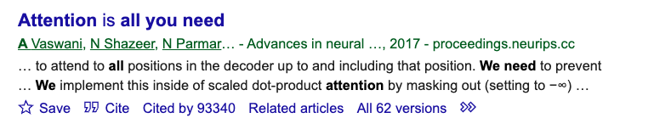
Hello Transformers - the new pre-train and fine-tune paradigm
Neural networks before transformers
Transformer BERT was introduced in 2017
Single-layer perceptron
Multi-layer perceptron
Convolutional neural network
An example of masked language modeling
“Seoul is the [mask] city of South Korea.”
Recursive neural network
Long short term memory (LSTM)

Slide 13
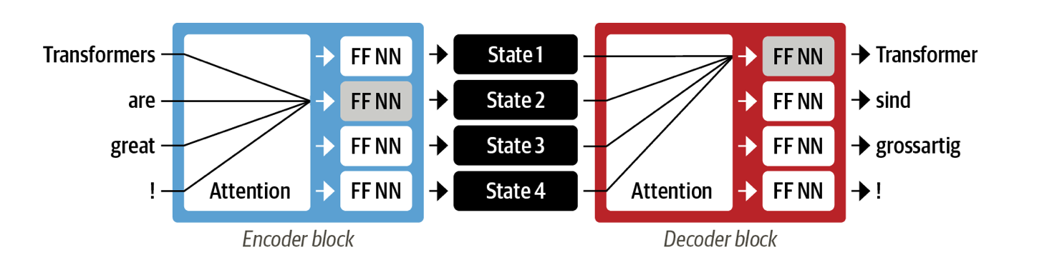
Transformer
FF NN: feed-forward neural network
Base BERT model has 12 attention layers
With the transformers, a new modeling paradigm was introduced: dispense with recurrent altogether, and instead rely entirely on a special form of attention called self-attention, which allows attention to operate on all the states in the same layer of the neural network.
This architecture can be trained much faster than recurrent models and paved the way for many of the recent breakthroughs in NLP.

Slide 14
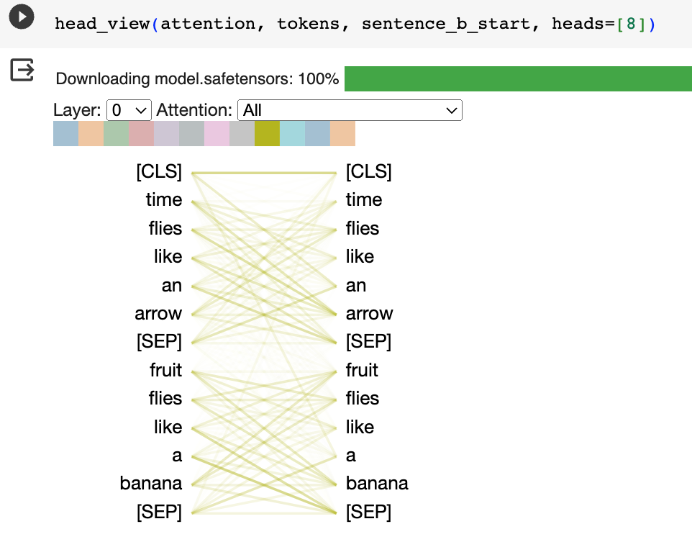
Attention mechanism

Slide 15
Transformers pave the road for transfer learning
Language Models (LMs) are trained on large datasets, in the process learning robust general-purpose features of the language it is modeling.
Pre-trained LMs will then be adapted to different downstream tasks by introducing additional parameters and fine-tuning them using task-specific objective functions

Slide 16
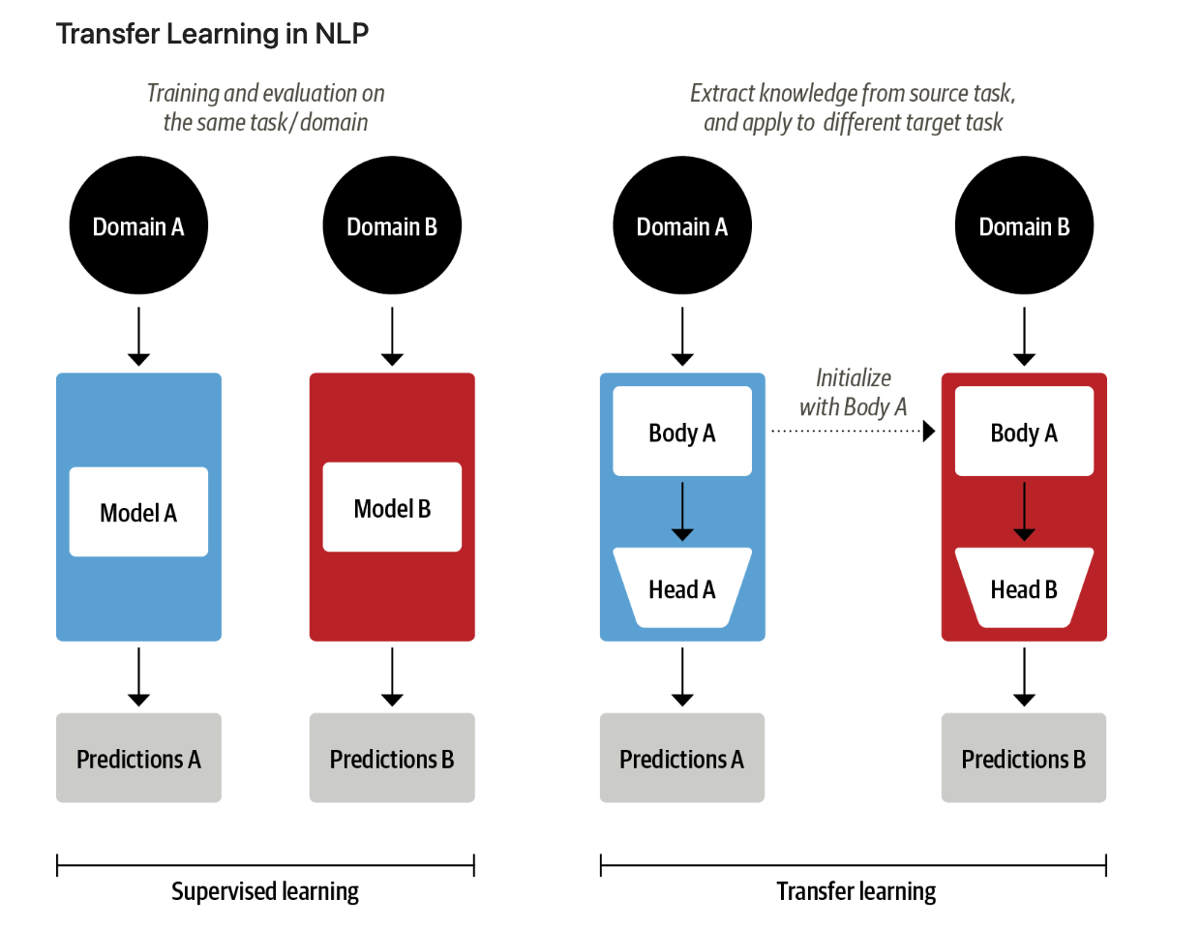

Slide 17
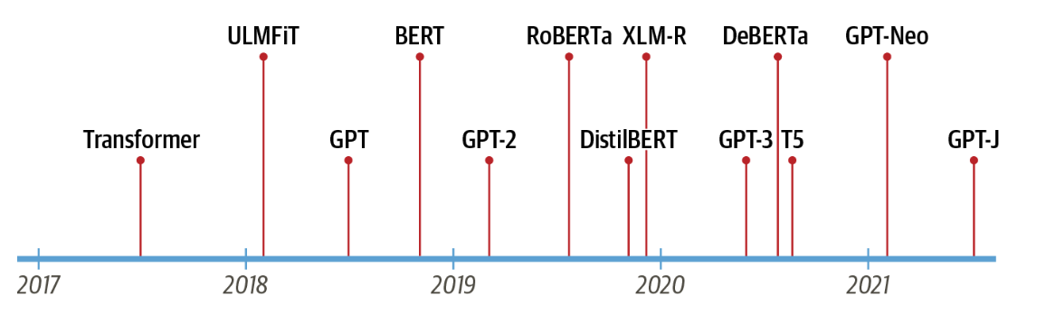
Transformers
GPT and BERT set a new state of the art across a variety of NLP benchmarks and ushered in the age of transformers
GPT – uses the decoder only
BERT – uses the encoder only

Slide 18
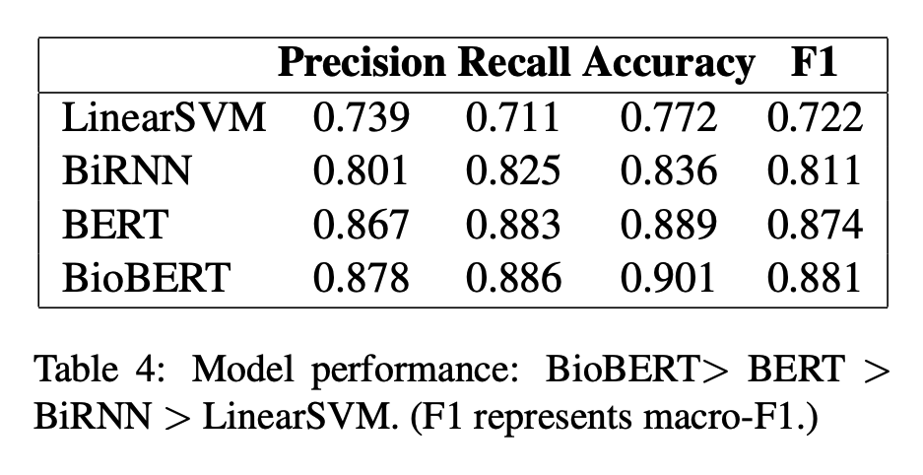
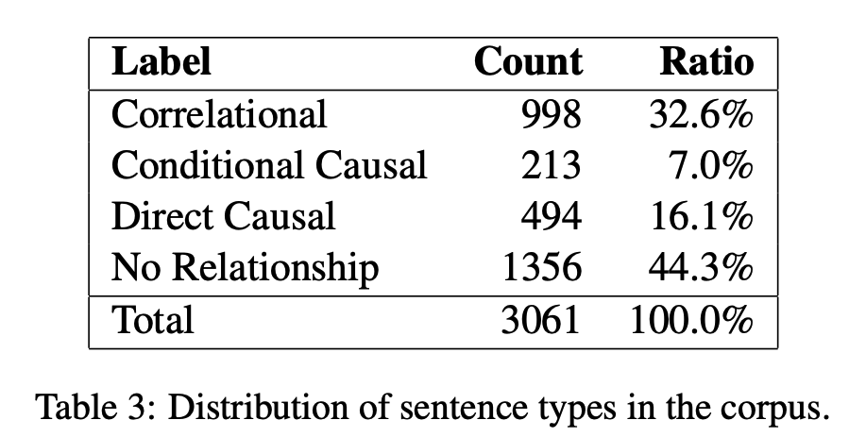
Fine-tune transformers
E.g. fine-tune BERT and BioBERT for identifying causal claims in research findings.
Yu, B., Li, Y., & Wang, J. (2019). Detecting causal language use in science findings. EMNLP-IJCNLP (pp. 4664-4674).

Slide 19
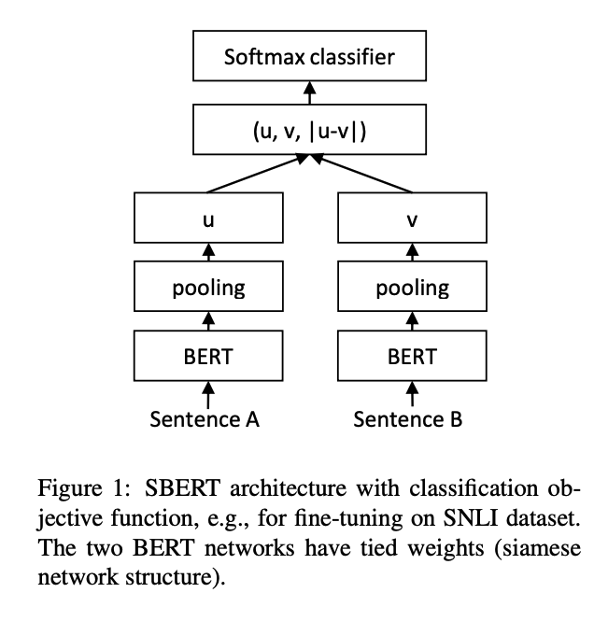
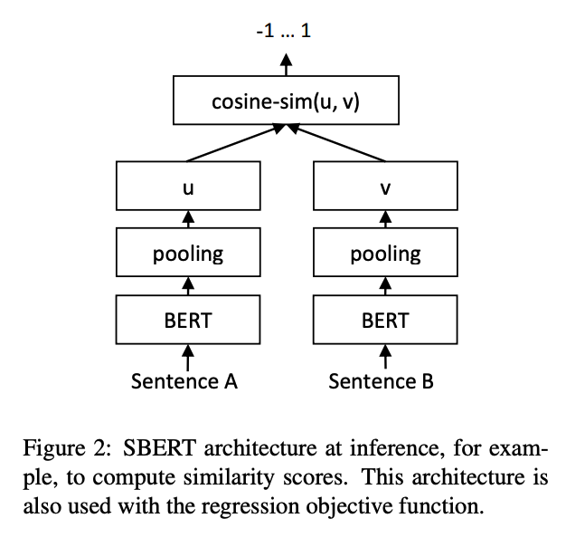
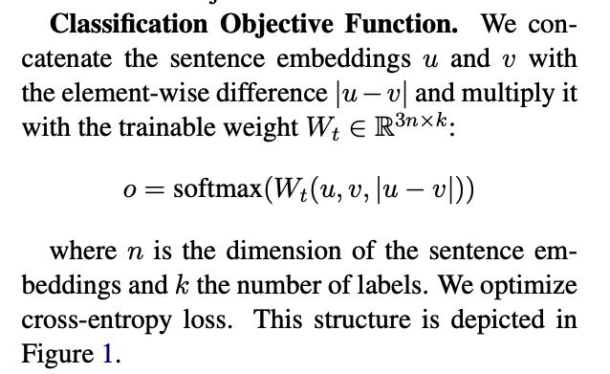
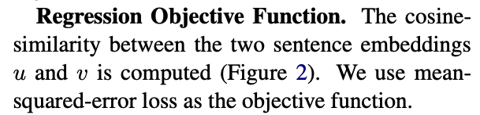
Sentence-BERT
Reimers, N., & Gurevych, I. (2019). Sentence-bert: Sentence embeddings using siamese bert-networks. arXiv preprint arXiv:1908.10084.

Slide 20
Training task – Semantic Textual Similarity
“We train SBERT on the combination of the SNLI (Bowman et al., 2015) and the Multi-Genre NLI (Williams et al., 2018) dataset. The SNLI is a collection of 570,000 sentence pairs annotated with the labels contradiction, entailment, and neutral. “
Premise | Hypothesis | label
His favorite color is blue. | He is into heavy metal music | Neutral
She finds the joke hilarious. | She thinks the joke is not funny at all. | contradiction
The house was recently built. | The house is new. | entailment

Slide 21
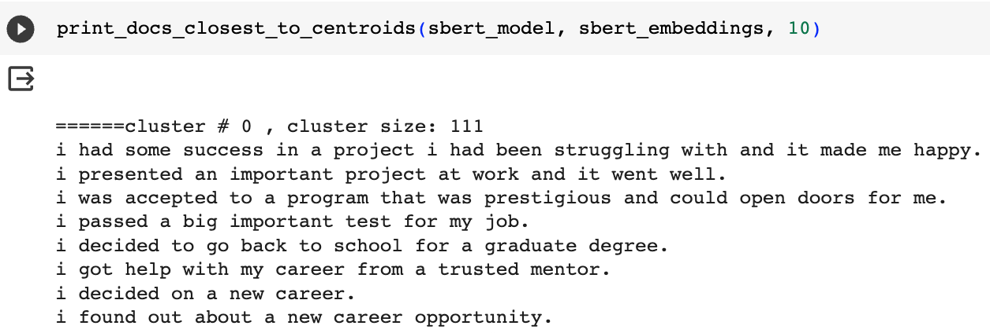
Sentence-BERT
Pre-trained sentence embedding models can then be used for classification and clustering tasks
E.g. clustering happy moments

Slide 22
From “pre-train and fine-tune” to “pre-train, prompt and predict”
Instead of adapting pre-trained LMs to downstream tasks, downstream tasks are reformulated to look more like those solved during the original LM training with the help of a textual prompt.
E.g. task: sentiment analysis
prompt: “I missed the bus today. I felt so [mask]”
Or task: machine translation
Prompt: “English: I missed the bus today. French: ”
This method introduces the necessity for prompt engineering, finding the most appropriate prompt to allow a LM to solve the task at hand

Slide 23
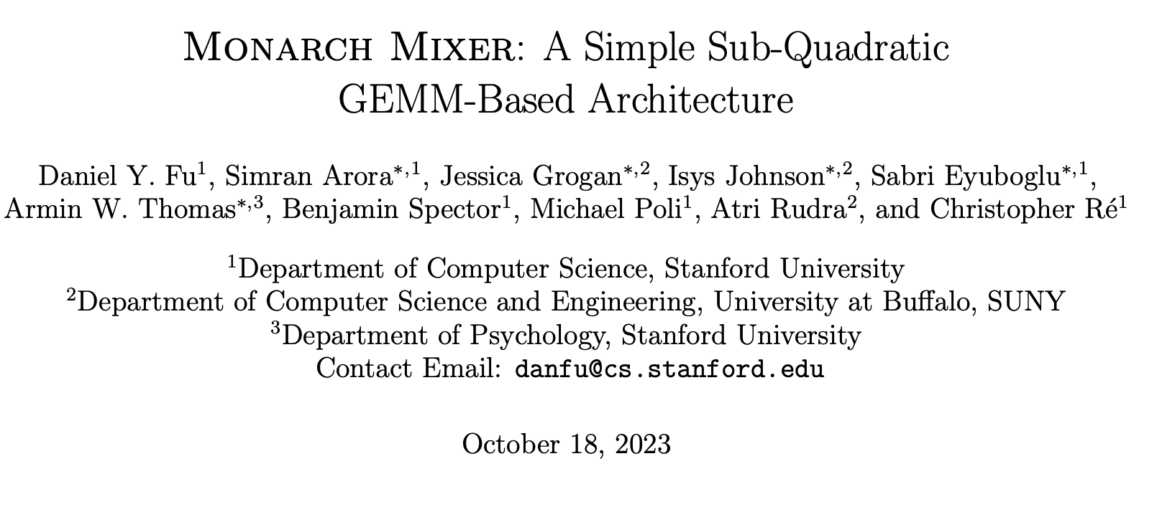
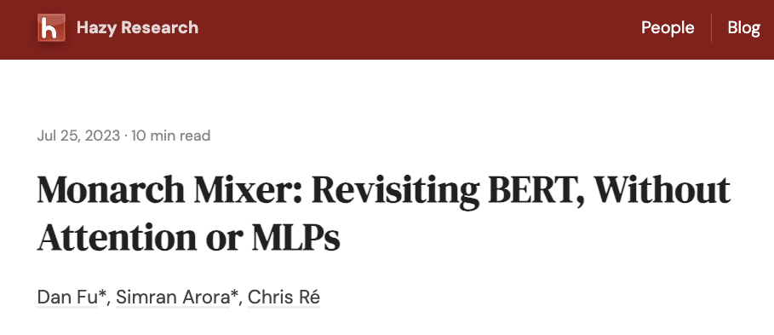

Are transformers the only way to get this amazing performance?
Alternative approach for building LLMs more efficiently without attention and MLPs?
Fu, D. Y., Arora, S., Grogan, J., Johnson, I., Eyuboglu, S., Thomas, A. W., ... & Ré, C. (2023). Monarch Mixer: A Simple Sub-Quadratic GEMM-Based Architecture. arXiv preprint arXiv:2310.12109.

Slide 24
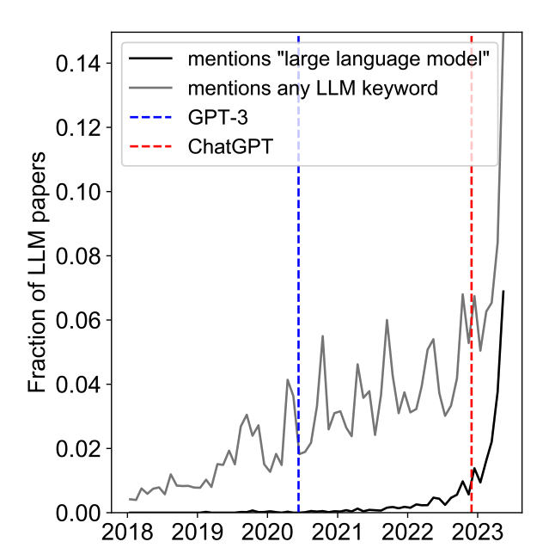
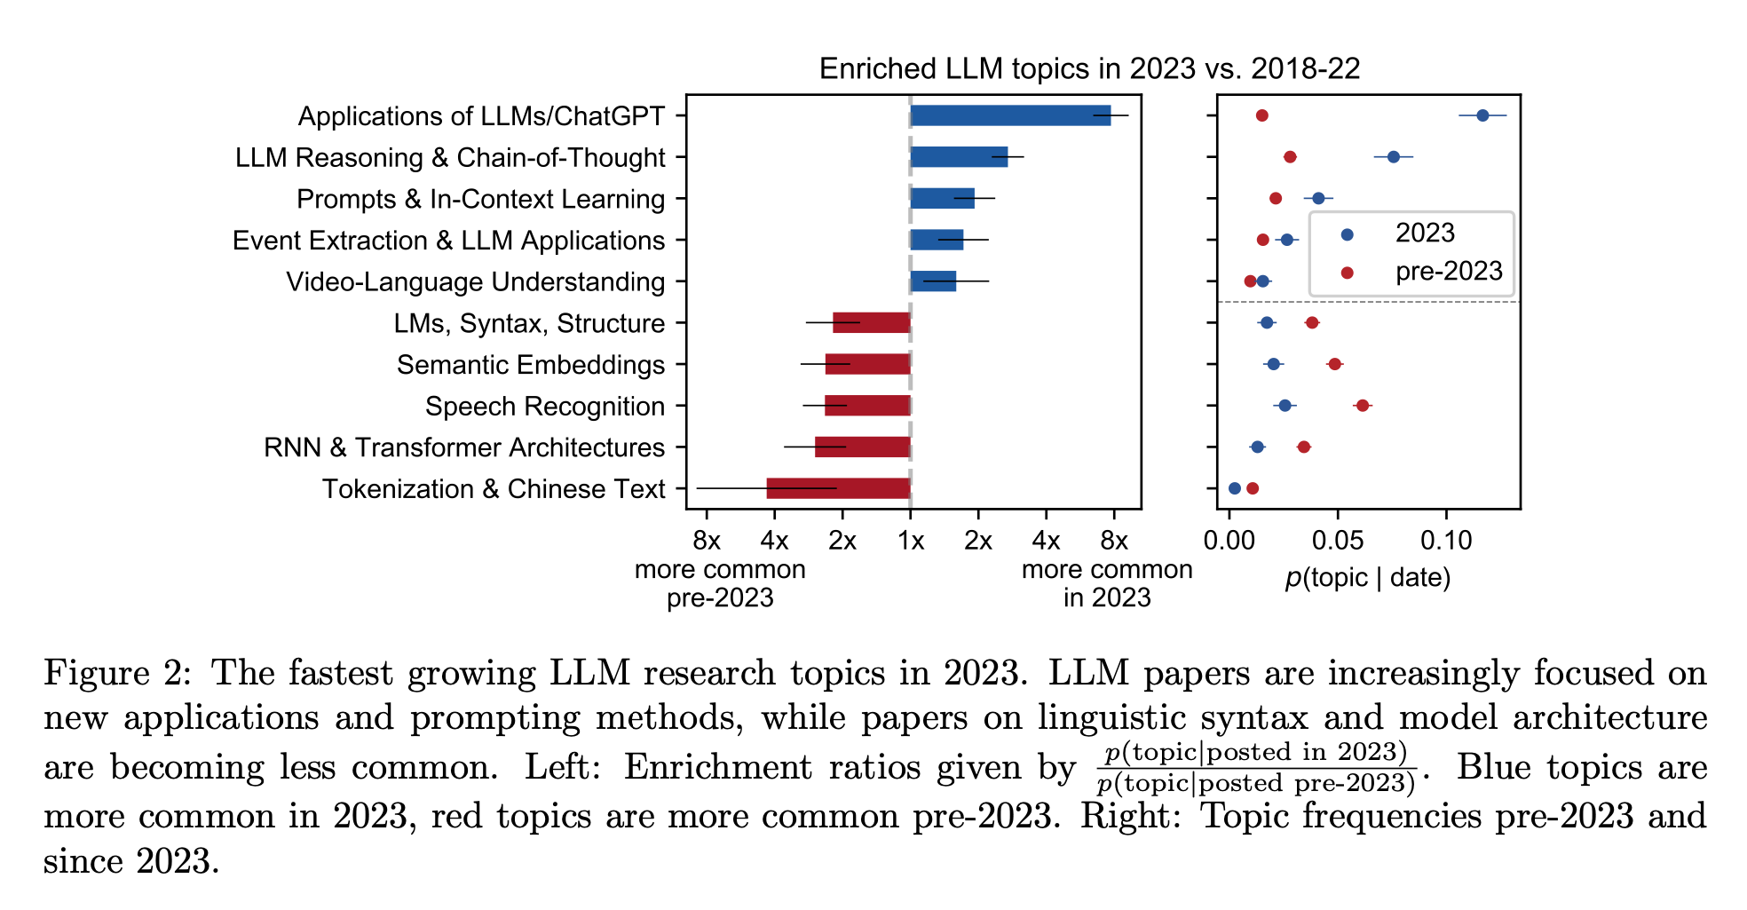
Topic Modeling of Arxiv Papers on LMs
Movva, R., Balachandar, S., Peng, K., Agostini, G., Garg, N., & Pierson, E. (2023). Large language models shape and are shaped by society: A survey of arXiv publication patterns. arXiv preprint arXiv:2307.10700.

Slide 25
Discussion
NLP applications for metadata?

Slide 26
Part II – Prompt Engineering Strategies

Slide 27
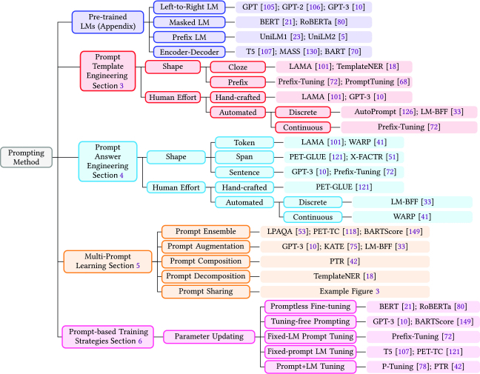
Typology of prompting methods
Liu, P., Yuan, W., Fu, J., Jiang, Z., Hayashi, H., & Neubig, G. (2023). Pre-train, prompt, and predict: A systematic survey of prompting methods in natural language processing. ACM Computing Surveys, 55(9), 1-35.

Slide 28
Prompt engineering strategies for text classification
A few commonly used strategies
Zero shot (no training examples needed)
Filled mask
instruction
In-context learning / few shots (requires only a few training examples)
Chain-of-thought

Slide 29
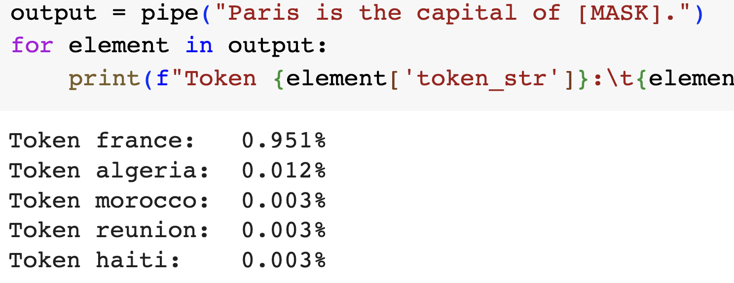
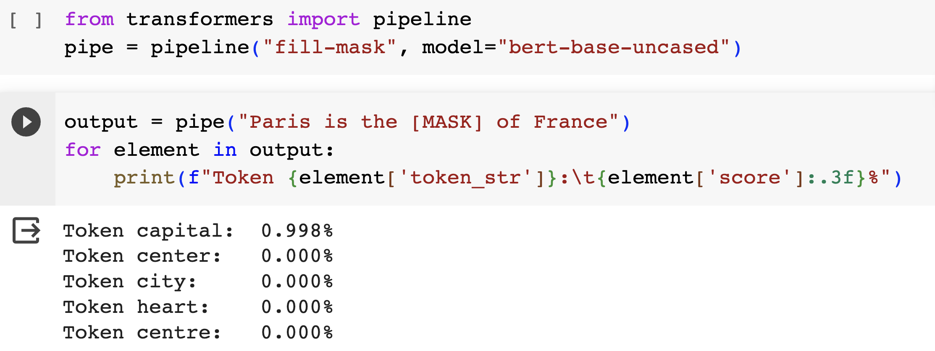
Zero-shot prompt with filled mask
Language models like BERT are pretrained to predict masked tokens in text on thousands of books and large Wikipedia dumps.
To successfully predict a missing token, the model needs to be aware of the topic in the context.

Slide 30
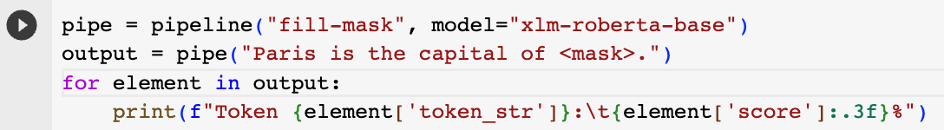
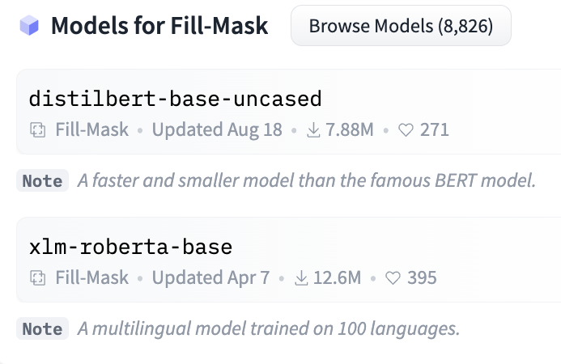
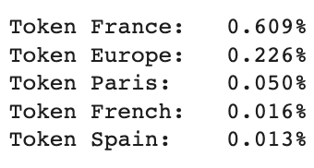
Choose models for fill-mask prompts

Slide 31
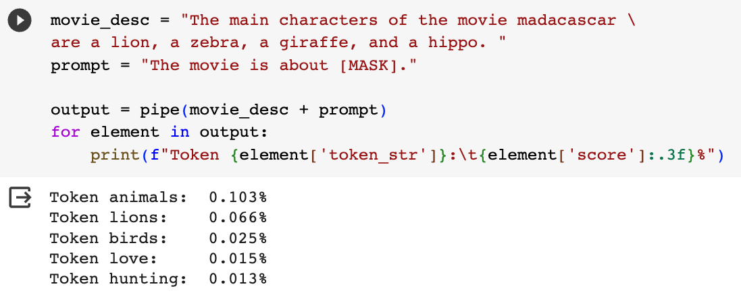
Filled-mask for topic classification
We can trick the pre-trained model to act like a text classifier using zero-shot filled-mask prompts.

Slide 32
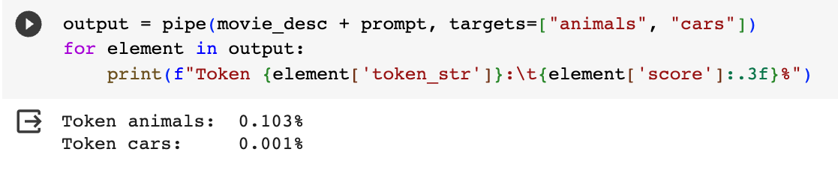
Or specify your targets for classification

Slide 33
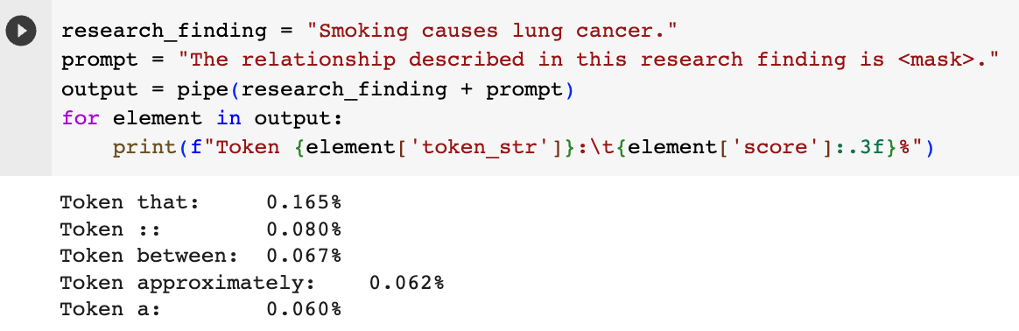
A challenging task

Slide 34
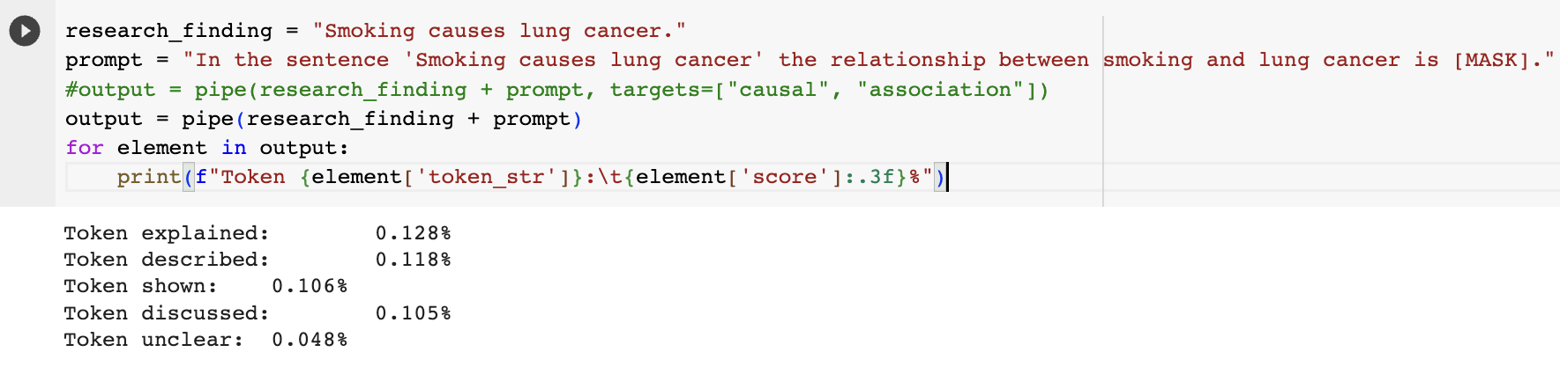
A challenging task

Slide 35
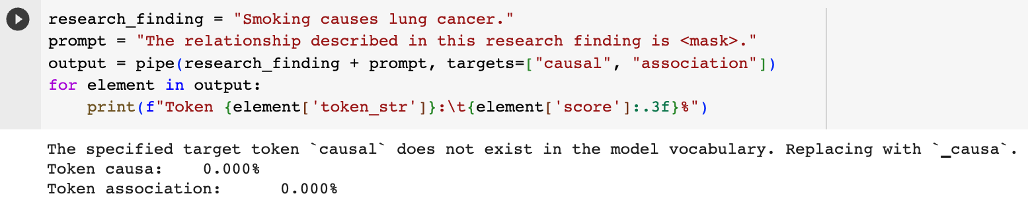
A challenging task

Slide 36
Alternative solution - Use a different pre-trained model that has been trained on a task similar to yours
E.g. NLI (natural language inference) - each sample in these datasets is composed of three parts: a premise, a hypothesis, and a label, which can be one of entailment (hypothesis is true), contradiction (hypothesis is false) , or neutral (neither)
Premise | Hypothesis | label
His favorite color is blue. | He is into heavy metal music | Neutral
She finds the joke hilarious. | She thinks the joke is not funny at all. | contradiction
The house was recently built. | The house is new. | entailment

Slide 37
We can hijack a model trained on the MNLI dataset to build a zero-shot classifier
Premise = [the text to classify]
Hypothesis = “This example is about {label}”.
The entailment score tells us how likely the premise is about that topic
Run this for each class label sequentially.
Suitable for multi-label classification too.
Challenge : the choice of label names can have a large impact on the accuracy.

Slide 38
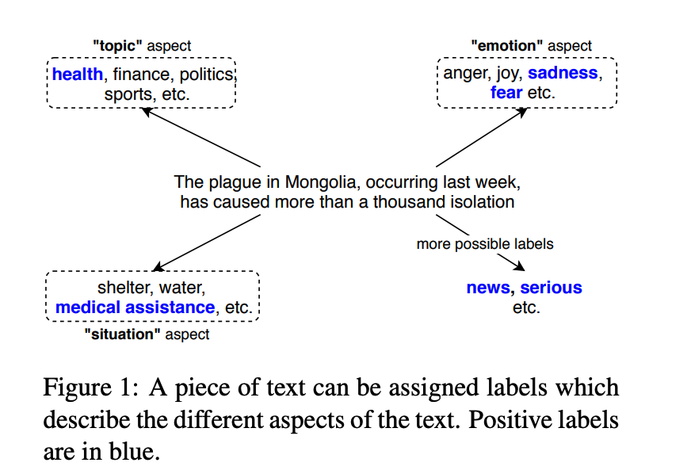
Zero-shot text classification
Yin, W., Hay, J., & Roth, D. (2019, November). Benchmarking Zero-shot Text Classification: Datasets, Evaluation and Entailment Approach. In Proceedings of the 2019 Conference on Empirical Methods in Natural Language Processing and the 9th International Joint Conference on Natural Language Processing (EMNLP-IJCNLP) (pp. 3914-3923).

Slide 39
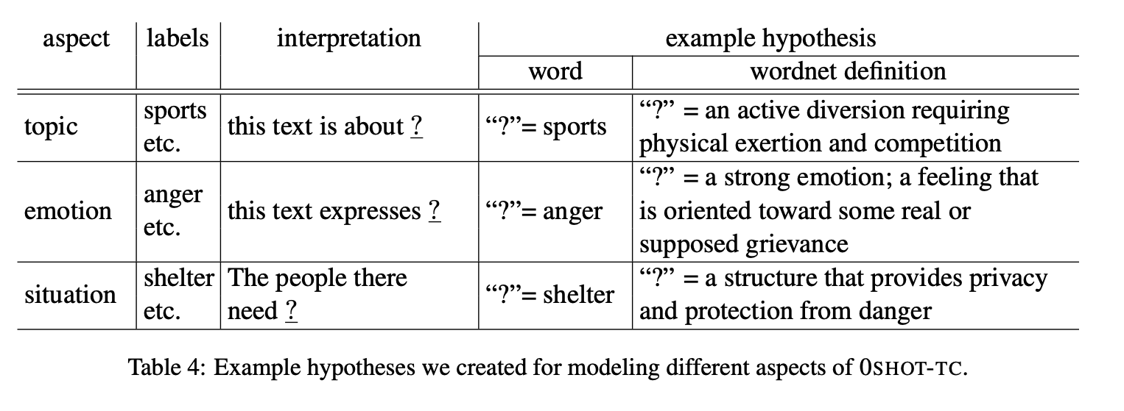
Text classification task modeled as an entailment task

Slide 40
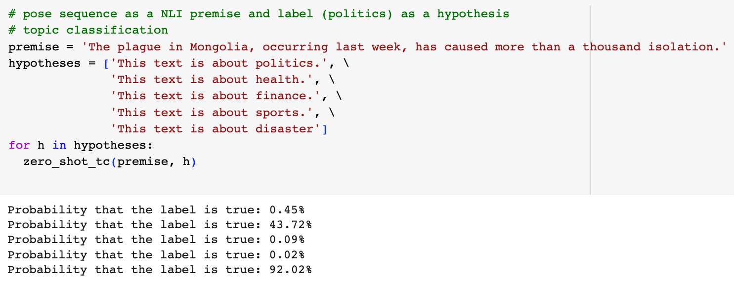
Code adapted from https://joeddav.github.io/blog/2020/05/29/ZSL.html

Slide 41
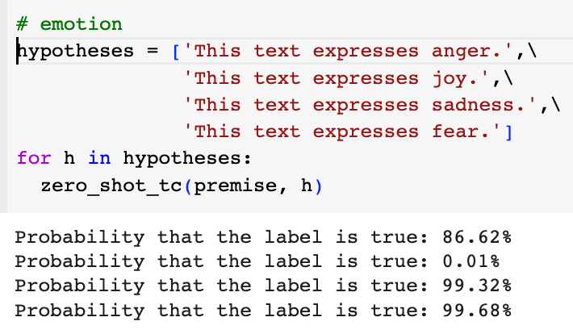
Code adapted from https://joeddav.github.io/blog/2020/05/29/ZSL.html

Slide 42
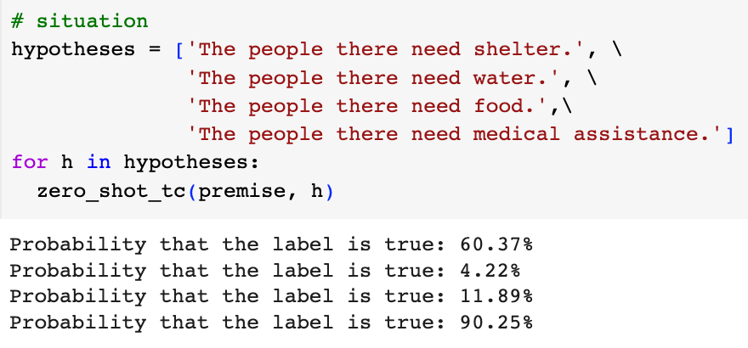
Code adapted from https://joeddav.github.io/blog/2020/05/29/ZSL.html

Slide 43
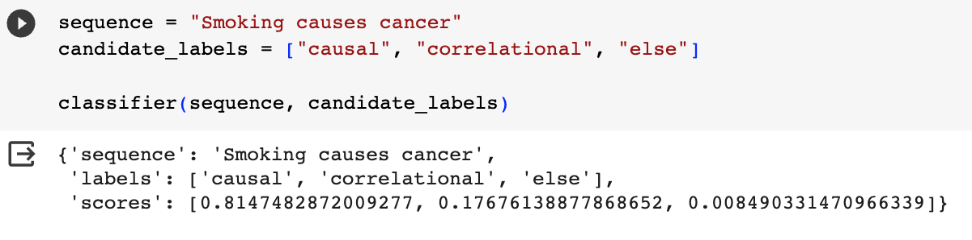
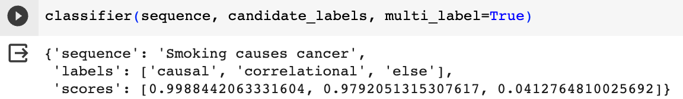
Huggingface zero shot classification pipeline

Slide 44
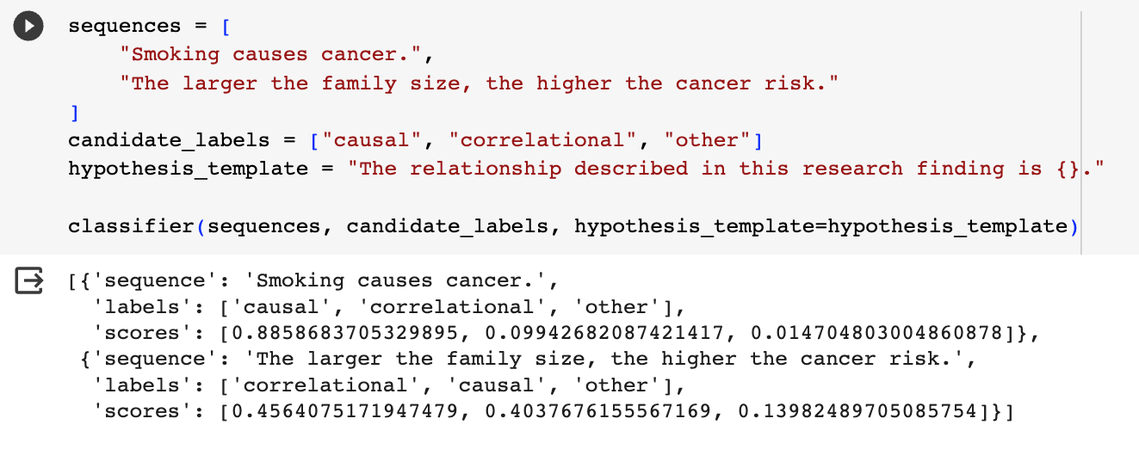
You can change the hypothesis template
Bias in LLM?

Slide 45
Discussion
Any metadata applications that could use the filled-mask prompts with BERT or NLI-style prompts with BART?

Slide 46
Prompt engineering with ChatGPT
Left-to-right language models (autoregressive)
Manually create a prompt based on templates
Add context and background
Ask ChatGPT to generate prompt and adapt
Add Chain-of-thought (CoT)
Add few-shot examples

Slide 47
Case study - Use chatGPT to identify “Critique” Citations?
Can GPT-4 identify a “critique” citation where an author [Opinion Holder] expressed opinion toward the cited paper [Target of Opinion] or quoted someone else’s opinion [Opinion Holder] toward the cited paper [Target of Opinion].
”Critique” citations are relatively rare, compared to other types of citations, since researchers prefer objective vs. subjective writing. They appear more often in review papers.
Traditional machine learning methods that we tried had difficulty identifying Critique citations.

Slide 48
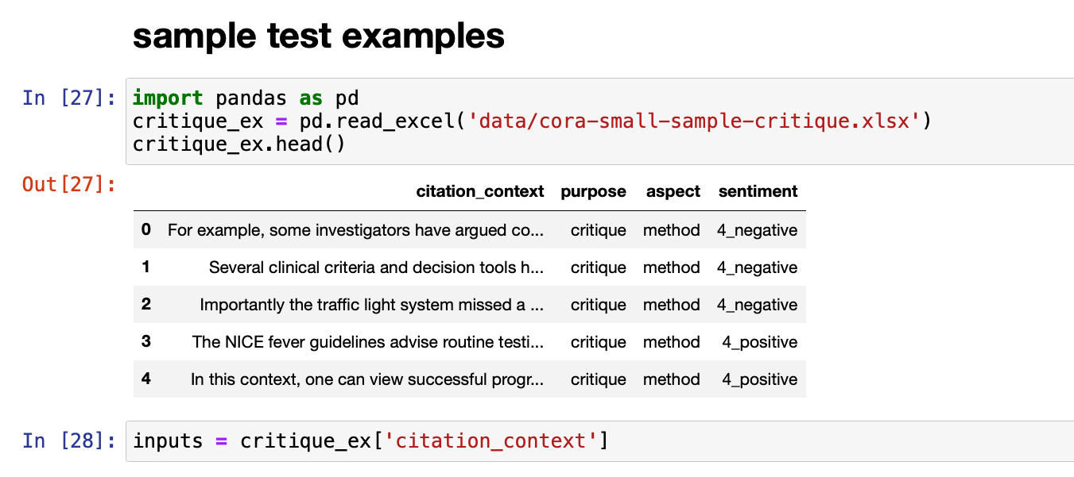
Set up a small test
Small test set: 10 critique citations (manually annotated)
Measure: Recall (how many critiques are identified?)
Approach: zero-shot prompts

Slide 49
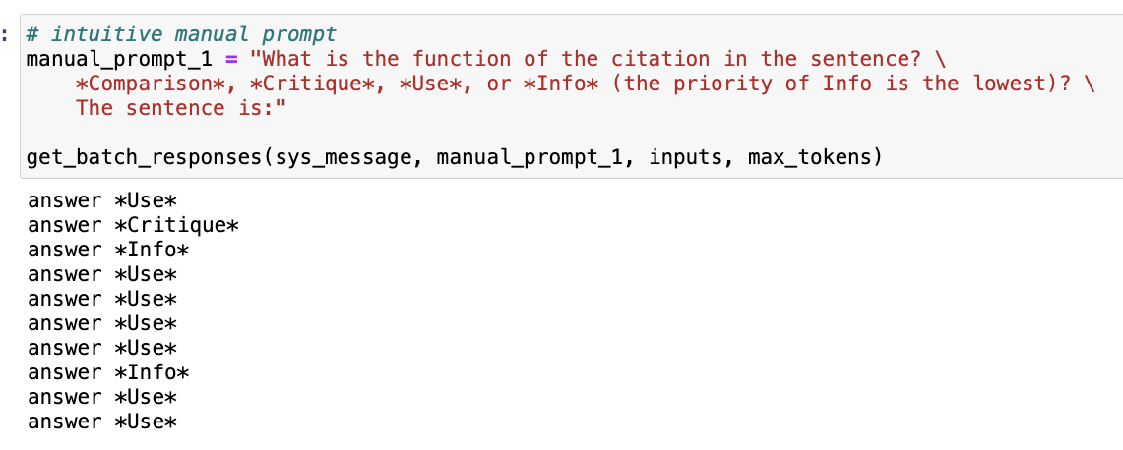
Manual Prompt #1 Question-answer style prompt

Slide 50
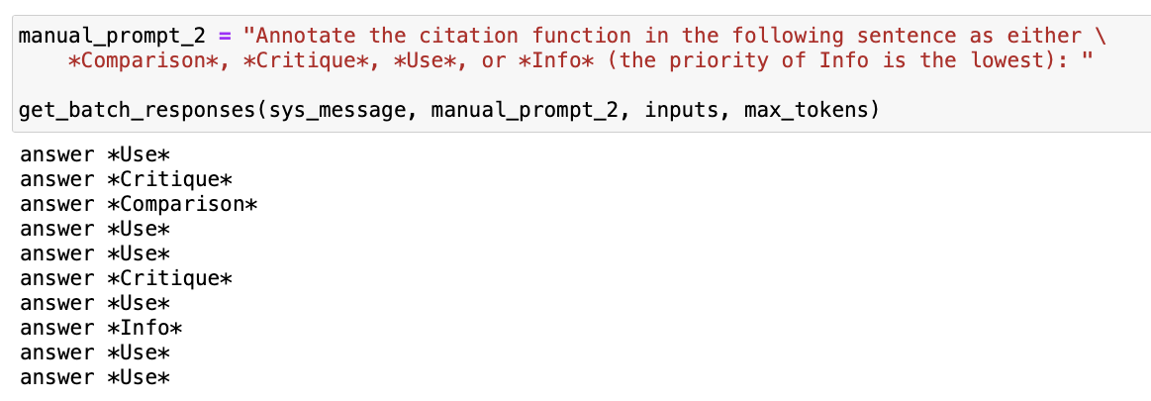
Manual Prompt #2 Instruction-style prompt

Slide 51
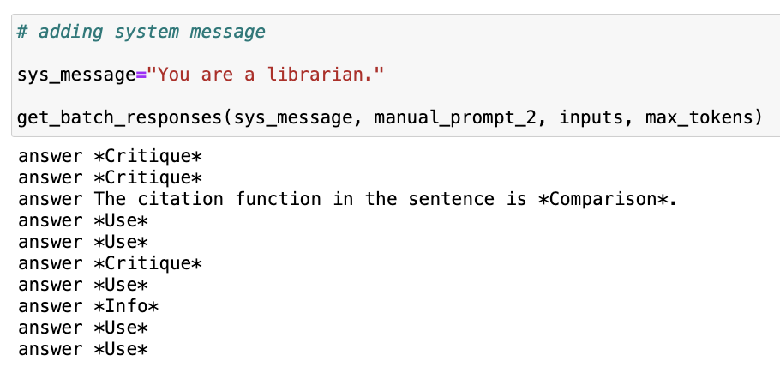
Add persona-style system message

Slide 52
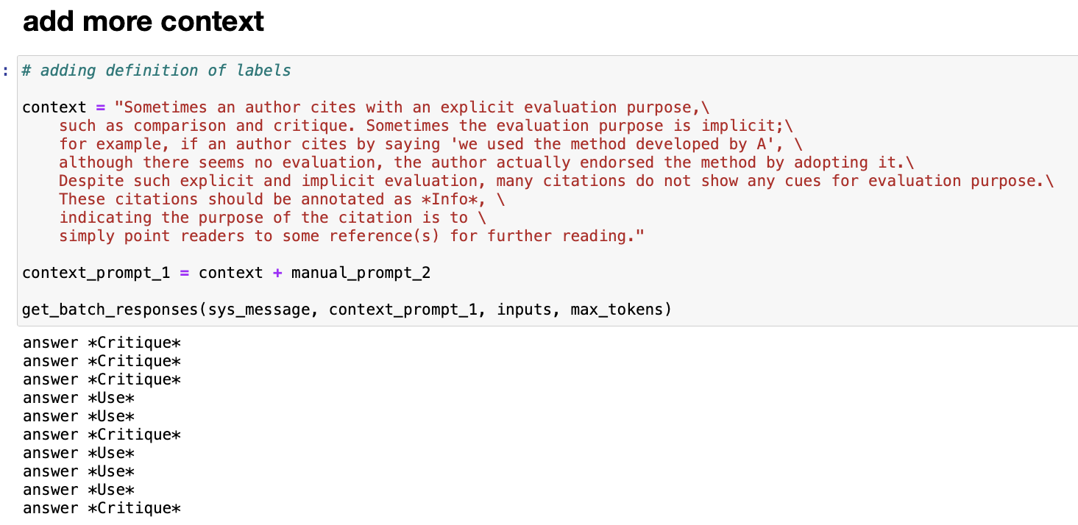
Add more context

Slide 53
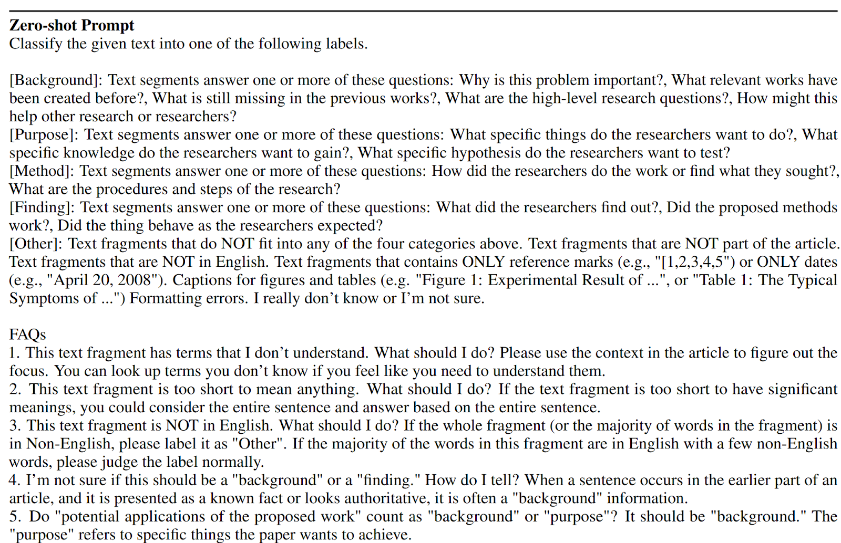
Adding FAQs as context

Slide 54
Chain-of-thought (CoT)
“Let's think step by step” (Wei et al., 2022).
Mainly used in reasoning tasks (Qiao et al., 2022).
It also is broadly used in classification tasks, for example, “Answer (yes or no) the question step by step” (Zhong et al., 2023).
Changing the wording in CoT can also impact the results (Kim et al., 2023).
A survey paper about CoT: https://proceedings.neurips.cc/paper_files/paper/2022/hash/9d5609613524ecf4f15af0f7b31abca4-Abstract-Conference.html

Slide 55
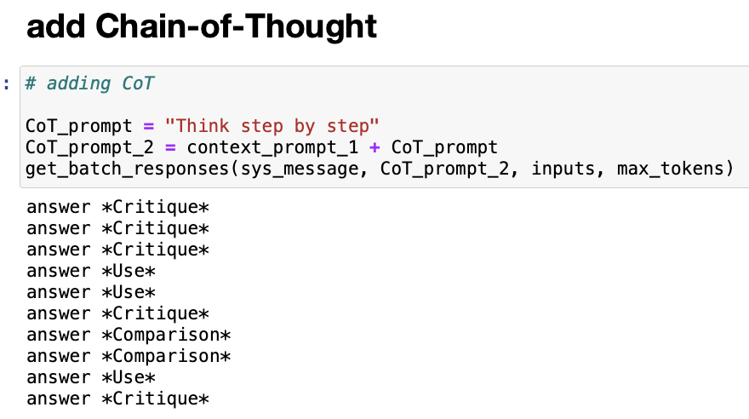
Add Chain-of-Thought

Slide 56

Ask GPT-4 how it defines Critique citations

Slide 57

Use GPT-4 definition as prompt

Slide 58

Adapt GPT4 definition
Remove the sentence related to *comparison* citation

Slide 59
Prompt performance comparison
GPT4-Prediction | Manual #1 | Manual #2 | Sys msg | More context | CoT | GPT4 def | Adjusted GPT4 def
Critique | 1 | 2 | 3 | 5 | 5 | 4 | 4
Comparison | 0 | 1 | 1 | 0 | 2 | 2 | 1
Use | 7 | 6 | 5 | 5 | 3 | 4 | 5
Info | 2 | 1 | 1 | 0 | 0 | 0 | 0
Total | 10 | 10 | 10 | 10 | 10 | 10 | 10

Slide 60
Prompt performance comparison same prompts tested one week ago
GPT4-Prediction | Manual #1 | Manual #2 | Sys msg | More context | CoT | GPT4 def | Adjusted GPT4 def
Critique | 1 | 2 | 3 | 4 | 4 | 4 | 4
Comparison | 0 | 1 | 1 | 2 | 2 | 1 | 1
Use | 5 | 7 | 6 | 3 | 3 | 5 | 4
Info | 4 | 0 | 0 | 1 | 1 | 0 | 0
Total | 10 | 10 | 10 | 10 | 10 | 10 | 9

Slide 61
Few-shot learning (Brown et al., 2020)
zero-shot
﻿What is the function of the citation in the sentence: {citation_context}?
one-shot
﻿What is the function of the citation in the sentence?
The candidate feature templates include : Voice from Sun and Jurafsky (2004) .
Intent: Use.
{citation_context}"
few-shot
﻿What is the function of the citation in the sentence?
The candidate feature templates include : Voice from Sun and Jurafsky (2004) .
Intent: Use.
This is a similar conclusion to our previous work in Salloum and Habash (2011).
Intent: Compare Or Contrast
{citation_context}"

Slide 62
Strategies for selecting few-shot examples
The selection of specific examples can significantly impact the accuracy of the language model (Zhao et al., 2021).
Random sampling (Sun et al., 2023)
kNN sampling (Khandelwal et al., 2020; Yu et al., 2023)
kNN cluster the training data
Select representative words in each cluster
Select sentences with the most representative words from training data
Sun, X., Li, X., Li, J., Wu, F., Guo, S., Zhang, T., & Wang, G. (2023). Text Classification via Large Language Models. arXiv preprint arXiv:2305.08377.
Zhao, Z., Wallace, E., Feng, S., Klein, D., & Singh, S. (2021, July). Calibrate before use: Improving few-shot performance of language models. In International Conference on Machine Learning (pp. 12697-12706). PMLR.
Yu, F., Quartey, L., & Schilder, F. (2023, July). Exploring the Effectiveness of Prompt Engineering for Legal Reasoning Tasks. In Findings of the Association for Computational Linguistics: ACL 2023 (pp. 13582-13596).
Khandelwal, U., Fan, A., Jurafsky, D., Zettlemoyer, L., & Lewis, M. (2020). Nearest neighbor machine translation. arXiv preprint arXiv:2010.00710.

Slide 63
Discussion
Metadata applications that can directly prompt chatGPT for solutions?

Slide 64

Part III Prompt Engineering – Science or Alchemy?

Slide 65
Systematic evaluation of prompt-engineering strategies
Case studies on single NLP tasks
Evaluations on multiple NLP tasks
Investigations on bias in LLM responses to prompts
Note that many studies are posted to Arxiv, being cited without peer review

Slide 66
Case study - How does ChatGPT understand causal language in science findings?
Compare chatGPT and fine-tuned BERT model in identifying causal language in science claims
Models: GPT (text-davinci-003) and chatGPT (gpt-3.5-turbo)
Dev set: 200 sample sentences for prompt engineering
Test set: 3,061 sentences from PubMed abstracts and 2,076 sentences from EurekAlert! press releases
Kim, Y., Guo, L., Yu, B., & Li, Y. (2023, July). Can ChatGPT Understand Causal Language in Science Claims?. In Proceedings of the 13th Workshop on Computational Approaches to Subjectivity, Sentiment, & Social Media Analysis (pp. 379-389).

Slide 67

Prompt engineering

Slide 68

Prompt engineering

Slide 69
Finding #1 ChatGPT can’t beat fine-tuned BERT model yet
 | chatGPT | BioBERT
correlational | .570 | .921
Conditional causal | .164 | .822
Direct causal | .537 | .868
No relationship | .674 | .911

Slide 70
Finding #2 ChatGPT has a different internal definition on “conditional causal” claims
After prompting ChatGPT to define “conditional causal”, and observing ChatGPT’s Chain-of-Thought responses for predicting conditional causal claims, we found that ChatGPT’s internal definition is “possible causal” instead of “conditional causal”
After changing one word in the prompt, performance gain from .164 to .578 F1
chatGPT may have inherited the confusion among human readers regarding conditional causal claims

Slide 71

Finding #3 Semantically-similar prompts resulted in different results

Slide 72

Finding #4 CoT helps
“Experiments on three large language models show that chain-of-thought prompting improves performance on a range of arithmetic, commonsense, and symbolic reasoning tasks.”
Wei, J., Wang, X., Schuurmans, D., Bosma, M., Xia, F., Chi, E., ... & Zhou, D. (2022). Chain-of-thought prompting elicits reasoning in large language models. Advances in Neural Information Processing Systems, 35, 24824-24837.

Slide 73
ChatGPT for genre classification
Huang, F., Kwak, H., & An, J. (2023). Is chatgpt better than human annotators? potential and limitations of chatgpt in explaining implicit hate speech. arXiv preprint arXiv:2302.07736.
“ChatGPT correctly identifies 80% of the implicit hateful tweets.”
“For those 20% disagreement cases, ChatGPT’s results are more likely to align with lay people’s perceptions. ”
“ChatGPT-generated NLEs can reinforce human perception, and they tend to be perceived as clearer than human-written NLEs. These results pose an important question. Since ChatGPT can be convincing, its capability would become a risk of misleading lay people if its decision is wrong. This highlights that it would require extra caution when using ChatGPT as a tool for assisting data annotation.”

Slide 74
Empirical evidence from other studies

Slide 75
ChatGPT for genre classification
Kuzman, T., Ljubešić, N., & Mozetič, I. (2023). Chatgpt: beginning of an end of manual annotation? Use case of automatic genre identification. arXiv preprint arXiv:2303.03953.
“ChatGPT outperforms the fine-tuned model when applied to the dataset which was not seen before by either of the models.”
“However, if the model is fully prompted in Slovenian, the performance drops significantly, showing the current limitations of ChatGPT usage on smaller languages.”

Slide 76
ChatGPT evaluation on multiple NLP tasks
Qin, C., Zhang, A., Zhang, Z., Chen, J., Yasunaga, M., & Yang, D. (2023). Is ChatGPT a general-purpose natural language processing task solver?. arXiv preprint arXiv:2302.06476.
“Zero-shot learning ability of ChatGPT by evaluating it on 20 popular NLP datasets covering 7 representative task categories. “
“ChatGPT performs well on many tasks favoring reasoning capabilities (e.g., arithmetic reasoning) while it still faces challenges when solving specific tasks such as sequence tagging.”

Slide 77
“Jack of all trades, master of none?”
Kocoń, J., Cichecki, I., Kaszyca, O., Kochanek, M., Szydło, D., Baran, J., ... & Kazienko, P. (2023). ChatGPT: Jack of all trades, master of none. Information Fusion, 101861.
Based on ChatGPT’s responses to 48k+ prompts related to 25 different NLP tasks, most of them subjective even to humans, such as sentiment analysis, emotion recognition, offensiveness, and stance detection. In contrast, the other tasks require more objective reasoning like word sense disambiguation, linguistic acceptability, and question answering.
ChatGPT loses to the best models currently available (SOTA), from 4 to over 70%.
Its loss is relatively greater for more difficult and pragmatic tasks, especially when evaluating emotional texts. All this makes ChatGPT a master of none of the task.

Slide 78
Chain-of-Thought
“we show how such reasoning abilities emerge naturally in sufficiently large language models via a simple method called chain-ofthought prompting, where a few chain of thought demonstrations are provided as exemplars in prompting.”
“Experiments on three large language models show that chain-of-thought prompting improves performance on a range of arithmetic, commonsense, and symbolic reasoning tasks.”
Wei, J., Wang, X., Schuurmans, D., Bosma, M., Xia, F., Chi, E., ... & Zhou, D. (2022). Chain-of-thought prompting elicits reasoning in large language models. Advances in Neural Information Processing Systems, 35, 24824-24837.

Slide 79
Empirical studies on few-shot prompts

Slide 80

What Causes Instability in Few-shot Prompts?
GPT-3 - the choice of prompt format, training examples, and even the order of the training examples can cause accuracy to vary from near chance to near state-of-the-art.
we show that the variance arises because LMs are biased towards outputting answers that are (1) frequent in the prompt (majority label bias), (2) towards the end of the prompt (recency bias), and (3) common in the pre-training data (common token bias).
http://proceedings.mlr.press/v139/zhao21c/zhao21c.pdf

Slide 81

Majority Label Bias
“GPT-3 is biased towards answers that are frequent in the prompt. A trivial case is when a text classification prompt has a class imbalance, e.g., more Positive than Negative sentiment examples.”
“The majority label bias also explains why we frequently observe a drop in accuracy when moving from 0-shot to 1-shot—we found that the drop is due to the model frequently repeating the class of the one training example.”

Slide 82

Recency Bias
The model’s majority label bias is aggravated by its recency bias: the tendency to repeat answers that appear towards the end of the prompt. For instance, when two Negative examples appear at the end (P P N N), the model will heavily prefer the Negative class.
Moreover, the recency bias can outweigh the majority label bias, e.g., the “P P P N” training set leads to nearly 90% of predictions being Negative, despite 3 4 of the training examples being Positive.

Slide 83
Common Token Bias
GPT-3 is biased towards outputting tokens that are common in its pretraining distribution, which is likely suboptimal for the distribution of answers on the downstream task.
A simple case of this occurs for the LAMA fact retrieval dataset, where the model often predicts common entities such as “America” when the ground-truth answer is instead a rare entity.

Slide 84
Order of few-shot examples affects prompt performance
This phenomenon is present across model sizes, irrelevant to a specific subset of samples, and that a given good permutation for one model is not transferable to another.
Proposed solution based on GPT-3
“we use the generative nature of language models to construct an artificial development set and based on entropy statistics of the candidate permutations on this set, we identify performant prompts. Our method yields a 13% relative improvement for GPT-family models across eleven different established text classification tasks.”
Lu, Y., Bartolo, M., Moore, A., Riedel, S., & Stenetorp, P. (2022, May). Fantastically Ordered Prompts and Where to Find Them: Overcoming Few-Shot Prompt Order Sensitivity. In Proceedings of ACL 2022 (Volume 1: Long Papers) (pp. 8086-8098).

Slide 85
Summary of Empirical Evaluation of Prompt Strategies
Varied strength of evidence
Prompt successes are not guaranteed to generalize across LLMs or tasks
There seems consistent findings on effectiveness of Chain-of-Thought

Slide 86
Alternative strategy - use ChatGPT to generate synthetic data instead?
Tang, R., Han, X., Jiang, X., & Hu, X. (2023). Does synthetic data generation of llms help clinical text mining?. arXiv preprint arXiv:2303.04360.

Slide 87
Biomedical text mining
Biomedical Named-Entity Recognition (NER) task
Biomedical Relation Extraction (RE) task
Sentence “The symptoms suggest a possible case of rheumatoid arthritis.”
NER tagging “O O O O O O O B-Disease I-Disease O”
Sentence “Smoking causes cancer”
Relation e1=“smoking”, e2=“cancer”, r= causal

Slide 88

Benchmarking LLM on Biomedical NER and RE tasks – direct use of ChatGPT with zero-shot
“we asked ChatGPT to provide us with five concise templates that could be used to address biological NER and RE tasks. After testing the generated prompts on a validation set, we selected the most effective ones and added instructions for adapting them to suit downstream datasets, prompts are shown in Table 1.”

Slide 89


Zero-shot ChatGPT did not beat SOTA models particularly trained for NER and RE tasks

Slide 90
New approach - use ChatGPT to generate synthetic data and then train local models
This approach requires only a few examples (seeds) to generate the entire training dataset.
The local model can address privacy concerns since the synthetic data contains no patient-sensitive information.
Ask ChatGPT to generate prompt – “Provide five concise prompts or templates that can be used to generate data samples of [Task Descriptions].”
Then use each prompt to generate 10 data samples, compare their quality and select the best prompt.
Repeated this process, asking ChatGPT to augment five prompts based on the previous best prompt until we arrived at the optimal prompt for data generation after three rounds of testing.

Slide 91


Workflow

Slide 92

NER performance: zero-shot chatGPT << fine-tuned on synthetic data < fine-tuned on original data

Slide 93

RE performance: zero-shot chatGPT < fine-tuned on synthetic data < fine-tuned on original data

Slide 94

Can LLMs reason?
https://arxiv.org/abs/2309.14402

Slide 95
Knowledge Retrieval
We find that retrieving multiple attributes is nearly as easy as extracting individual ones. However, in this broader context, partial retrieval can be significantly more challenging. For instance, a language model may correctly answer “What is the birth date of Anya” as “June 27th, 1997”, but struggle with “What is the birth year of Anya ”.

Slide 96
Knowledge Classification
Classification tasks involve determining the validity of a statement based on individual attributes. For instance, answering “What degree did Anya receive?” requires a ternary response (art, science, engineering) based on her major of study.
The model can answer one’s birth month with nearly 100% accuracy, but can’t answer if the birth month is odd or even, even after further trained/finetuned with 25,000 individuals on birth-month parity questions (both with direct answers like “Alice’s birth month is even” and with Chain of Thoughts like “Alice’s birth month is 12, 12 is even”)

Slide 97
Knowledge Comparison
Comparison involves determining whether one attribute is greater or smaller than another, based on a predefined ranking or order. For example, “Is Anya’s university better than Sabrina’s?” requires a “Yes” or “No” response based on the universities and their ranking. Similar to classification, we find that language models can not be trained/finetuned efficiently to perform this type of knowledge manipulation unless they generate answers in a CoT manner.

Slide 98
Inverse Search
This involves identifying a person based on their attributes, such as “Who was born in 1996 in Princeton, NJ?” or “Who studied Communications at MIT and worked for Meta?”. We find that language models cannot perform this operation, no matter how it is trained or how large the number of training examples is, unless the knowledge is already presented inversely in the training data, such as “Born in 1991 in New York was Anya” or “Studied at MIT and worked for Meta was Anya ”. Simply having forward knowledge data like “Anya was born in 1996 in Princeton, NJ” or “Anya studied at MIT and worked for Meta” in the training is insufficient (with whatever augmentation/finetuning strategies). A concurrent work [2] also observed a similar “reverse curse”. This strongly suggests that language models cannot be used as databases.

Slide 99

ChatGPT for knowledge graph engineering
Meyer, L. P., Stadler, C., Frey, J., Radtke, N., Junghanns, K., Meissner, R., ... & Martin, M. (2023). Llm-assisted knowledge graph engineering: Experiments with chatgpt. arXiv preprint arXiv:2307.06917.

Slide 100
Discussion
Strength and limitations for prompt engineering methods in metadata applications.

